Slide 1
CSP571 Data Preparation and Analysis
Lecture 8. Dimensionality Reduction and Unsupervised Learning
Oleksandr Narykov
onarykov@iit.edu

Slide 2

Class Project
Team effort, 3-5 people. Teams of one are possible, but prior discussion is needed
https://docs.google.com/spreadsheets/d/1Anl1fpu3eU-8srwCMjr8SmoxWv_sHFWpSWTwS_4kBok/edit?usp=sharing
Recommended data source – Kaggle
Consider necessary compute time!
Timeline:
Oct 10 – teams are formed, dataset selected and registration spreadsheet filled
Nov 12,14 – Interim project review. Short 3-min presentation about your progress
Nov 30 – Final report is due. Approximately 5 pages + code in a publicly accessible git repository. Link should be included in the report document
39

Slide 3
Class Project Requirements
Explore dataset – correlation between features, their impact on target, independence assumptions
Try multiple visualization strategies: correlation plots, dimensionality reduction approaches – PCA, UMAP, t-SNE. Explain gained insights
Explore data using unsupervised learning techniques
Identify appropriate cross-validation strategy
Train a simple model first. Use validation set for hyperparameter tuning and/or early stopping. Analyze its performance using cross-validation. Identify potential pitfalls.
Propose ways to improve performance – e.g., feature selection, regularization, increasing model complexity. Conduct at least 2 more experiments
39

Slide 4
Dimensionality Reduction

Slide 5
Motivation
Remove useless features
Learn a low dimensional representation
Visualization
2

Slide 6
Approaches
Feature selection
Feature extraction
3

Slide 7
Feature Selection
Select a subset of the features
Several approaches
Univariate feature selection
Mutual information, Chi2
Recursive feature elimination
Using an external estimator, recursively remove the least useful features
Sequential feature selection
Model-based feature selection
L1 regularization, Random Forest, Boosting, Variance Inflation Factor
Sequential feature selection
Can use any model and performance metric
4

Slide 8
Feature Extraction
Feature extraction, projection, latent
representation learning, manifold learning, …
Given an input, project it into another dimension
(often lower)
Unsupervised
Principal component analysis, UMAP, isomap, t-SNE, deep
learning, …
Supervised
Linear discriminant analysis, deep learning, …
5

Slide 9
Feature Extraction
Projection, latent representation learning, manifold learning, …
Given an input, project it into another dimension
(often lower)
Feature engineering
Unsupervised
Principal component analysis, UMAP, isomap, t-SNE, deep
learning, …
Supervised
Linear discriminant analysis, deep learning, …
5

Slide 10
We’ll Cover
Principal component analysis
Autoencoder
6

Slide 11
Principal Component Analysis
Given a dataset 𝒙 with 𝑑 dimensions, project it into 𝑘 dimensions (𝑘 < 𝑑) with minimum loss of information
𝒛 = 𝒘^{𝑇}𝒙
Principal component analysis (PCA) maximizes the variance in the projected space so that objects are spread out
𝑎𝑟𝑔𝑚𝑎𝑥_{𝒘}𝑉𝑎𝑟(𝒛)
7

Slide 12
PCA Objective
𝒛 = 𝒘^{𝑇}𝒙
𝑎𝑟𝑔𝑚𝑎𝑥_{𝒘}𝑉𝑎𝑟(𝒛)
Reminder: 𝑉𝑎𝑟 𝑎𝑋 + 𝑏
𝑉𝑎𝑟 𝒛 = 𝒘^{𝑇}𝑉𝑎𝑟(𝒙)𝒘
= 𝑎²𝑉𝑎𝑟(𝑋)
We can trivially maximize variance by multiplying w by a large constant; hence, we enforce that 𝒘 is unit length
𝒘𝒘^{𝑇} = 1
Objective
maximize 𝒘^{𝑇}𝑉𝑎𝑟(𝒙)𝒘 subject to 𝒘𝒘^{𝑇} = 1
8

Slide 13
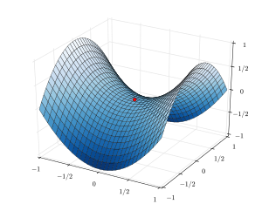
Background – Constrained optimization
Find θ
maximizing f (θ) subject to
c₁ (θ) = 0
...
c_{m} (θ) = 0
Form the Lagrangian:
𝒘𝒘^{𝑇} = 1
F (θ, λ) = f (θ) − ∑λ_{j}c_{j} (θ)
j =1
m
9

Slide 14
Example
Maximize 𝑥𝑦 subject to 𝑥 + 𝑦 = 10
Notes:
xy – lam (x+y-10)
d/dx
d/dy
d/dlam

Slide 15
PCA with One Dimension
maximize 𝑉𝑎𝑟 𝑧₁ = 𝑤^{𝑇}𝑉𝑎𝑟 𝒙 𝑤₁ subject to 𝑤^{𝑇}𝑤₁ = 1
1 1
Let the variance of 𝒙 be the covariance matrix Σ
Objective
Maximize 𝑤^{𝑇}Σ𝑤₁ subject to 𝑤^{𝑇}𝑤₁ = 1
1 1
Lagrange
maximize 𝑤^{𝑇}Σ𝑤₁ − 𝜆(𝑤^{𝑇}𝑤₁ − 1)
1 1
Take derivative with respect to 𝑤₁, set to zero
2Σ𝑤₁ − 2𝜆𝑤₁ = 0
Σ𝑤₁ = 𝜆𝑤₁
𝑤₁ is an eigenvector and 𝜆 is an eigenvalue of Σ
Because we maximize variance
maximize 𝑤^{𝑇}Σ𝑤₁ = 𝑤^{𝑇}𝜆𝑤₁ = 𝜆𝑤^{𝑇}𝑤₁ = 𝜆
1 1 1
𝑤₁is the eigenvector that corresponds to the largest eigenvalue of Σ
11

Slide 16
PCA with 𝑘 Dimensions
We want the second vector 𝑤₂ to be orthogonal to
𝑤₁ so that the 𝑧₂ is uncorrelated with 𝑧₁
Skipping the derivation details
𝑤₁ is the eigenvector for the largest eigenvalue 𝜆₁
𝑤₂ is the eigenvector for the second largest eigenvalue 𝜆₂
…
𝑤_{𝑘} is the eigenvector for the 𝑘^{𝑡ℎ} largest eigenvalue 𝜆_{𝑘}
In the end, the transformation is typically
centered around zero (in the new dimensions)
𝒛 = 𝐰^{T}(𝐱 − 𝐦) where 𝒎 is the mean of 𝒙
12

Slide 17
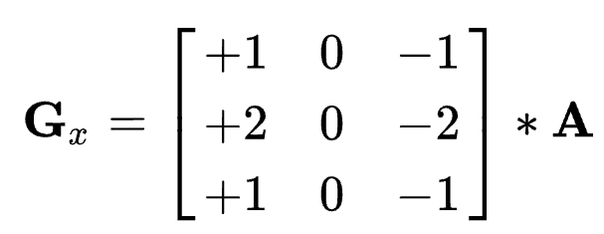
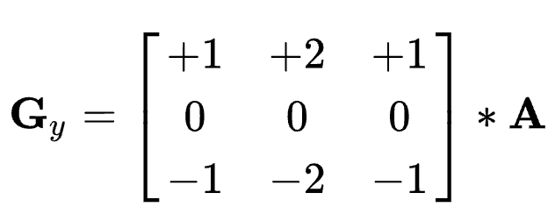
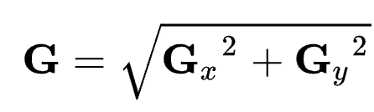
Feature Engineering
Using domain knowledge to transform data
Sobel operator in Computer Vision
5

Slide 18
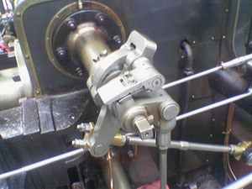
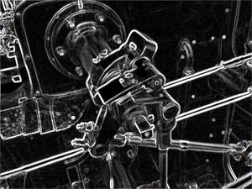
Feature Engineering
Using domain knowledge to transform data
Sobel operator in Computer Vision
5

Slide 19
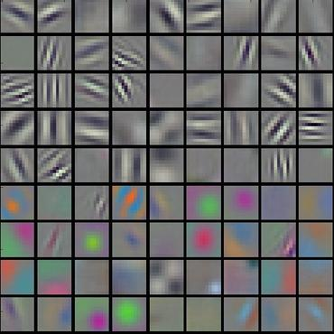
Convolution Network
End-to-end learning
Deep learning is representation learning
Weight matrices of hidden layers of convolution network

Slide 20
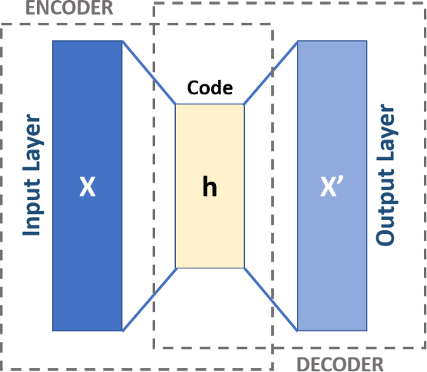
AutoEncoder
A neural network architecture where the input and output are the same
𝒙 → 𝒉 → 𝒙
Input x is encoded into h, where h is typically lower dimensional than x and h is decoded back to x, with some error
14
https://upload.wikimedia.org/wikipedia/commons/3/37/Autoencoder_schema.png

Slide 21
Other DL Methods
Transformers
Contrastive learning
…
International conference on learning representations (ICLR)
https://iclr.cc/
15

Slide 22
Unsupervised Learning

Slide 23
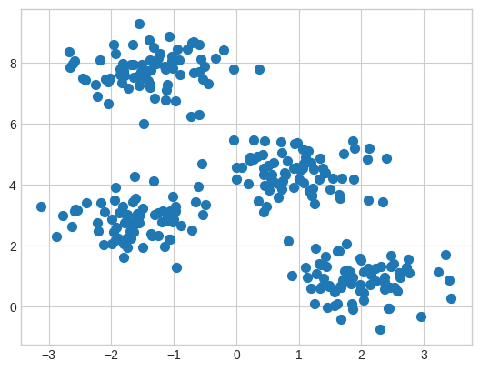
Clustering
Intuitively, clusters are the groups in the data for which points within the same group are more similar than the points from different groups
Mathematically, groups
of points are usually con-
sidered clusters when they
Form high-density regions
in a data space
2

Slide 24
Various Approaches
K-Means
Expectation Maximization (EM)
EM is a general approach that can be used for many
other tasks, one of which is clustering
Hierarchical clustering
DBScan
Spectral clustering
Mean-shift
… and many more
3

Slide 25
We’ll Cover
K-Means
EM for mixture of Gaussians
Spectral clustering
4

Slide 26
K-Means
Basic idea: given data, find k prototype vectors, and assign each data point to its closest prototype vector, such that the sum of the distances to the closest prototype vectors is minimized
𝑁
𝑗=1
Let 𝐷 = 𝑥
𝑘
𝑖=1
be the data and let 𝑚
be the
𝑗
𝑖
prototype vectors. Objective:
minimize ∑^{𝑁} min 𝑑𝑖𝑠𝑡𝑎𝑛𝑐𝑒 𝑥_{𝑗}, 𝑚_{𝑖}
𝑗=1
𝑖
A typical distance metric is Euclidan distance
5

Slide 27
K-Means
Initialize k centers 𝑚_{𝑖}
𝑘
𝑖=1
Repeat until convergence
Assign each data point 𝑥_{𝑗} to the closest cluster center
Re-compute each center 𝑚_{𝑖}
𝑘
𝑖=1
as the mean of the
points that are assigned to that center
6

Slide 28
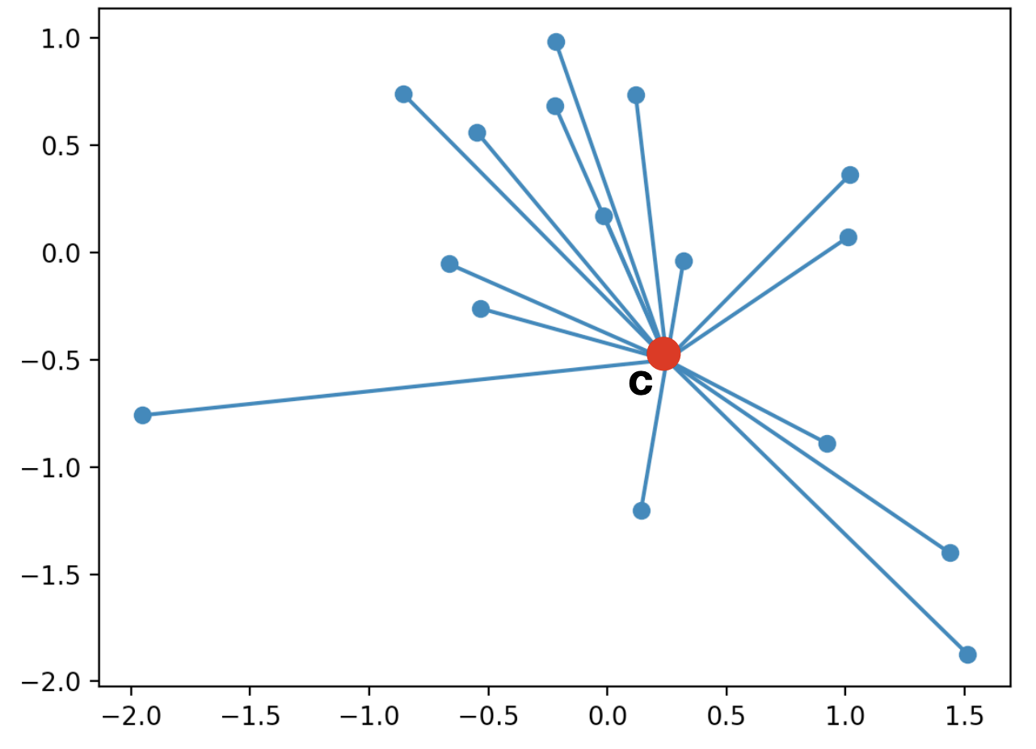
K-Means
Cluster centroid
6

Slide 29
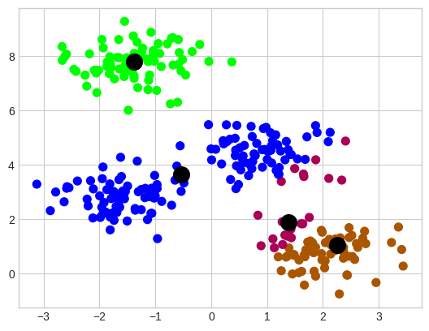
K-Means
Randomly initialized cluster centers
6

Slide 30
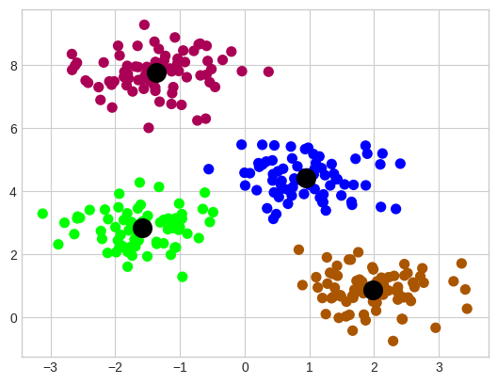
K-Means
Algorithm output after convergence (colors are changed)
6

Slide 31
K-Means
Algorithm output after convergence (colors are changed)
6

Slide 32
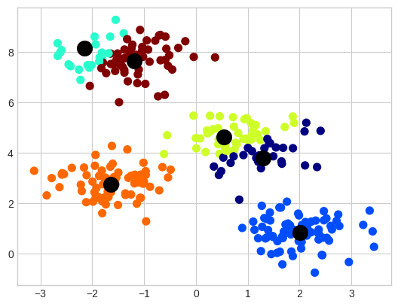
K-Means
Output of the K-Means with 6 clusters
6

Slide 33
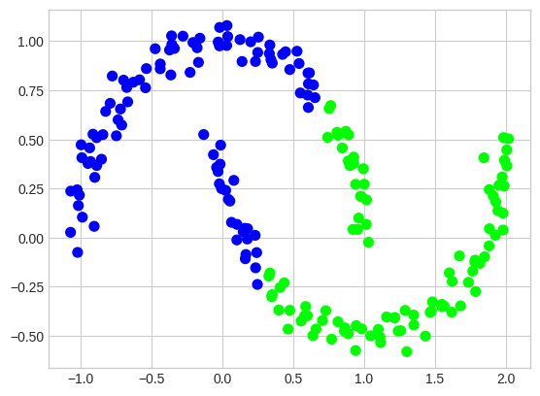
K-Means
Important assumption – clusters are convex
6

Slide 34
K-Means Summary
Requires specifying the number of clusters beforehand
No guarantee for convergence to the global minimum
Output is highly dependent on the initial centroids
Sometimes, clusters can become empty
6

Slide 35
EM for Mixture of Gaussians
Basic idea: very much like the Bayes classifier where we have P(C) and p(x|C) and we use that for computing P(C|x), except, in this case, classes are not given to us. So, we take an iterative approach
Repeat until convergence
Assign data points to classes/centers/components, probabilistically (i.e., compute P(C|x) using P(C) and p(x|C) ) – Expectation
Re-estimate class/center/component parameters based on the probabilistic assignments to classes/centers (i.e., recompute P(C) and p(x|C) using the probabilistic assignments) – Maximization
7

Slide 36
Notation
𝑃 𝐶_{𝑖} : prior probability of component 𝐶_{𝑖}
A multinomial distribution
𝑃 𝑥_{𝑗} 𝐶_{𝑖} : probability that component 𝐶_{𝑖} generated 𝑥_{𝑗}
A Gaussian distribution with mean 𝜇_{𝑖} and variance 𝜎²
𝑖
This can be easily generalized to multivariate Gaussian distribution with mean 𝜇_{𝑖} and co-variance Σ_{𝑖}
𝑃 𝐶_{𝑖} 𝑥_{𝑗} : probability that 𝑥_{𝑗} belongs to component 𝐶_{𝑖}
Via Bayes rule, 𝑃 𝐶_{𝑖} 𝑥_{𝑗} ∝ 𝑃 𝑥_{𝑗} 𝐶_{𝑖} 𝑃 𝐶_{𝑖}
𝑛_{𝑖}: Expected number of instances that belong to component 𝐶_{𝑖}
𝑛_{𝑖} = ∑^{𝑁} 𝑃 𝐶_{𝑖} 𝑥_{𝑗}
𝑗=1
8

Slide 37
EM
E step: compute cluster/component assignments
𝑃 𝐶_{𝑖} 𝑥_{𝑗} ∝ 𝑃 𝑥_{𝑗} 𝐶_{𝑖} 𝑃 𝐶_{𝑖}
M step: recompute parameters
𝑛_{𝑖} = ∑^{𝑁} 𝑃 𝐶_{𝑖} 𝑥_{𝑗}
𝑗=1
Weighted counts, where weights are 𝑃 𝐶_{𝑖} 𝑥_{𝑗}
𝑃 𝐶
₌ 𝑛_{𝑖}
𝑖
𝑁
𝑃 𝑥_{𝑗} 𝐶_{𝑖} ∼ Ν 𝜇_{𝑖}, 𝜎²
𝑖
∑𝑁
𝑃 𝐶 𝑥 𝑥_{𝑗}
𝜇_{𝑖} =
𝑗=1
𝑖 𝑗
𝑛
𝑖
Weighted mean, where weights are 𝑃 𝐶_{𝑖} 𝑥_{𝑗}
2
∑𝑁
𝑃 𝐶 𝑥 𝑥 −𝑚
𝑗=1
𝑖 𝑗
𝑗 𝑖
𝜎 ² =
𝑖
𝑛_{𝑖}
9
Weighted variance, where weights are 𝑃 𝐶_{𝑖} 𝑥_{𝑗}

Slide 38
EM
E step: compute cluster/component assignments
𝑃 𝐶_{𝑖} 𝑥_{𝑗} ∝ 𝑃 𝑥_{𝑗} 𝐶_{𝑖} 𝑃 𝐶_{𝑖}
M step: recompute parameters
𝑛_{𝑖} = ∑^{𝑁} 𝑃 𝐶_{𝑖} 𝑥_{𝑗}
𝑗=1
Weighted counts, where weights are 𝑃 𝐶_{𝑖} 𝑥_{𝑗}
𝑃 𝐶
₌ 𝑛_{𝑖}
𝑖
𝑁
𝑃 𝑥_{𝑗} 𝐶_{𝑖} ∼ Ν 𝜇_{𝑖}, 𝜎²
𝑖
∑𝑁
𝑃 𝐶 𝑥 𝑥_{𝑗}
𝜇_{𝑖} =
𝑗=1
𝑖 𝑗
𝑛
𝑖
Weighted mean, where weights are 𝑃 𝐶_{𝑖} 𝑥_{𝑗}
2
∑𝑁
𝑃 𝐶 𝑥 𝑥 −𝑚
𝑗=1
𝑖 𝑗
𝑗 𝑖
𝜎 ² =
𝑖
𝑛_{𝑖}
9
Weighted variance, where weights are 𝑃 𝐶_{𝑖} 𝑥_{𝑗}

Slide 39
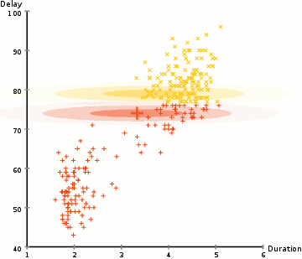
EM
https://upload.wikimedia.org/wikipedia/commons/6/69/EM_Clustering_of_Old_Faithful_data.gif
9

Slide 40
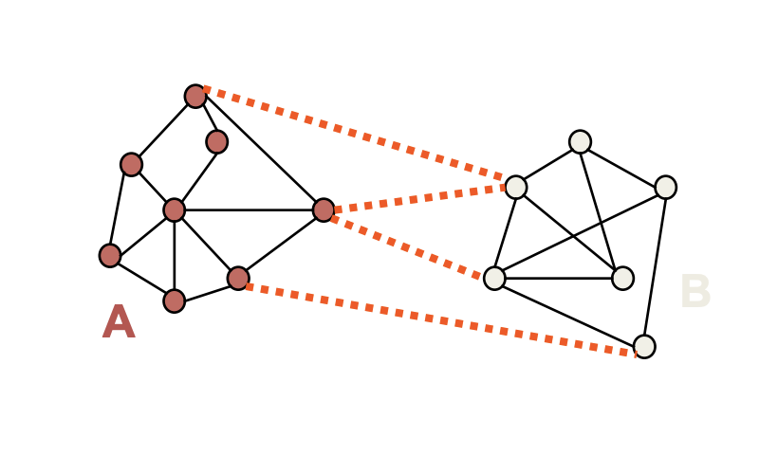
Spectral Clustering
EM and K-Means are limited by data shape assumptions
Potential solution: assign points that are close to each other to the same cluster
9

Slide 41
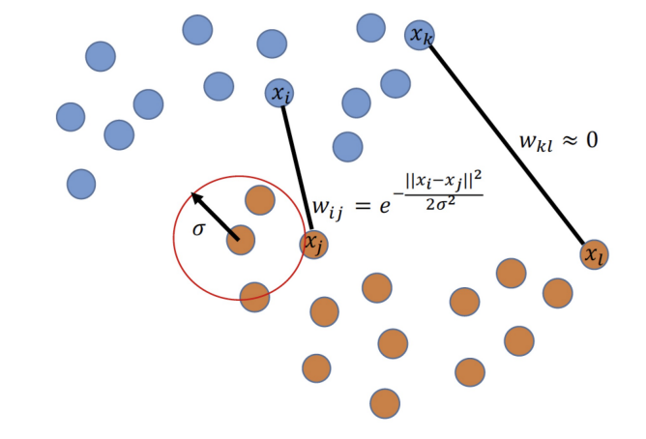
Spectral Clustering
Basic idea: group samples based graph communities
We need to construct a graph over datapoints
Similarity graph with a Gaussian kernel is a common approach
9

Slide 42
Spectral Clustering
Let’s separate the graph in two parts
Min-cut algorithm
Min-cut
Preferred cut
9

Slide 43
Spectral Clustering
Let’s separate the graph in two parts
Min-cut algorithm
Min-cut
Preferred cut
9

Slide 44
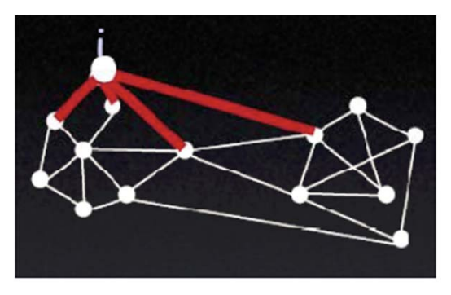
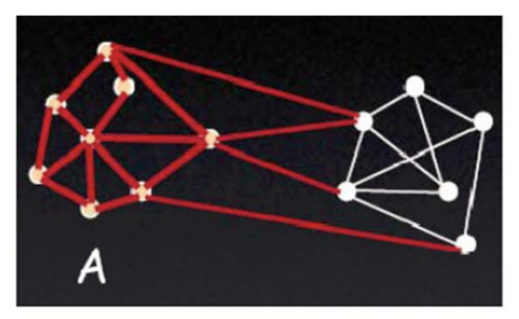
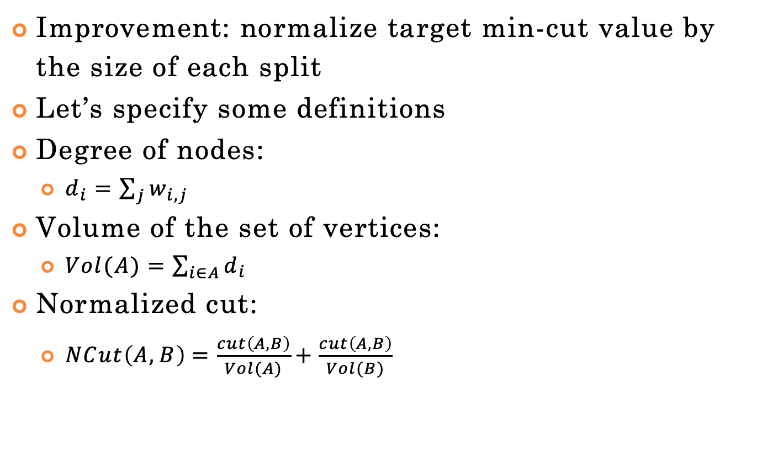
Spectral Clustering
Improvement: normalize target min-cut value by the size of each split
Let’s specify some definitions
Degree of nodes:
$d_{i}=\sum_{j}{w_{i,j}}$
Volume of the set of vertices:
$Vol(A)=\sum_{i∈A}{d_{i}}$
Normalized cut:
$NCut\left(A,B\right)=\frac{cut\left(A,B\right)}{Vol(A)}+\frac{cut\left(A,B\right)}{Vol(B)}$
https://people.csail.mit.edu/dsontag/
9

Slide 45
Spectral Clustering
Improvement: normalize target min-cut value by the size of each split
Let’s specify some definitions
Degree of nodes:
$d_{i}=\sum_{j}{w_{i,j}}$
Volume of the set of vertices:
$Vol(A)=\sum_{i∈A}{d_{i}}$
Normalized cut:
$NCut\left(A,B\right)=\frac{cut\left(A,B\right)}{Vol(A)}+\frac{cut\left(A,B\right)}{Vol(B)}$
https://people.csail.mit.edu/dsontag/
9

Slide 46
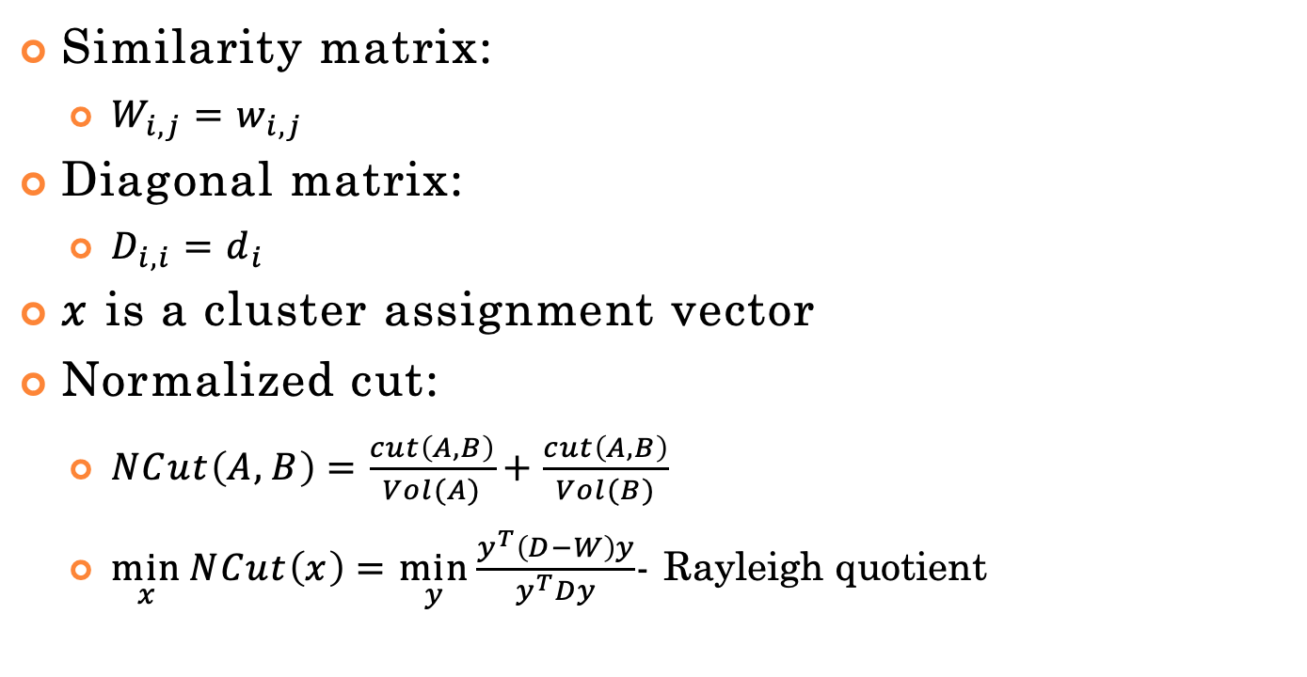
Spectral Clustering
Similarity matrix:
$W_{i,j}=w_{i,j}$
Diagonal matrix:
$x$ is a cluster assignment vector
Normalized cut:
$NCut\left(A,B\right)=\frac{cut\left(A,B\right)}{Vol(A)}+\frac{cut\left(A,B\right)}{Vol(B)}$
$\min_{x}{NCut\left(x\right)}=\min_{y}{\frac{y^{T}\left(D−W\right)y}{y^{T}Dy}}$- Rayleigh quotient
9

Slide 47
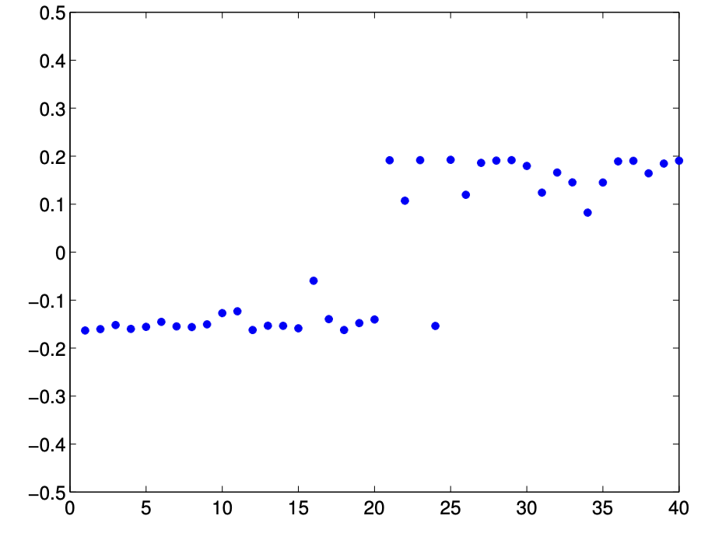
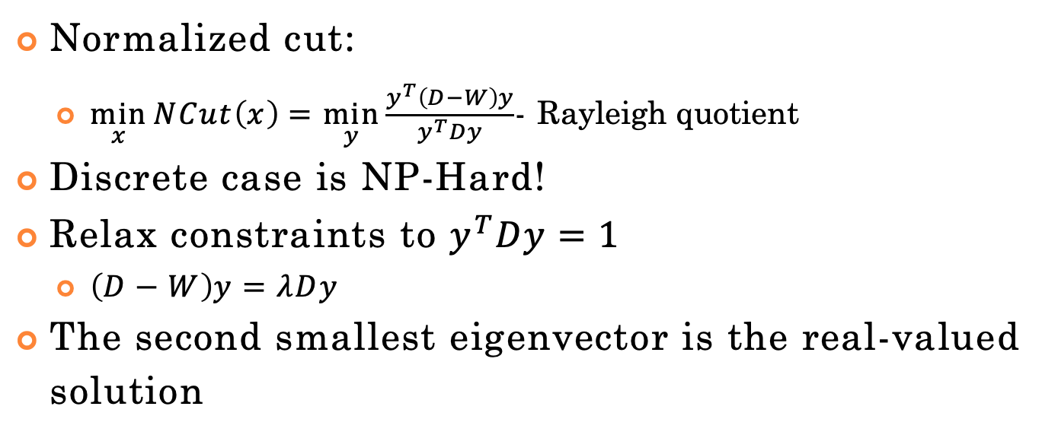
Spectral Clustering
Normalized cut:
$\min_{x}{NCut\left(x\right)}=\min_{y}{\frac{y^{T}\left(D−W\right)y}{y^{T}Dy}}$- Rayleigh quotient
Discrete case is NP-Hard!
Relax constraints to $y^{T}Dy=1$
$\left(D−W\right)y=λDy$
The second smallest eigenvector is the real-valued solution
9

Slide 48
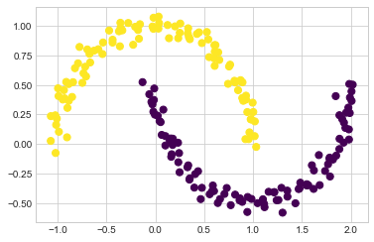
Spectral Clustering
9

Slide 49
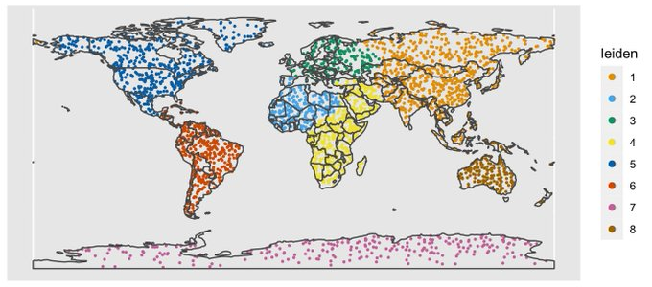
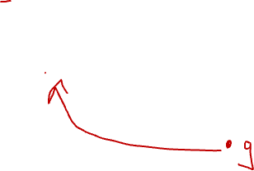
Leiden Clustering Example
https://github.com/lambdamoses/umap_globe
12

Slide 50
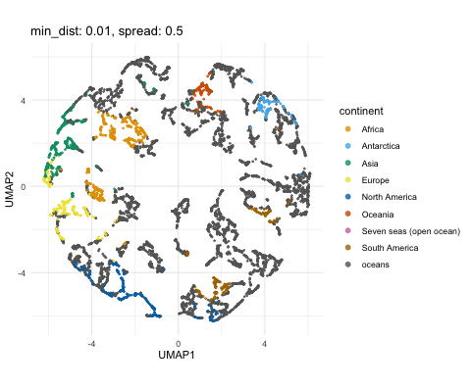
UMAP + Leiden Clustering Example
12
https://github.com/lambdamoses/umap_globe

Slide 51
Scikit-Learn
http://scikit- learn.org/stable/modules/clustering.html
10

